Slide 1
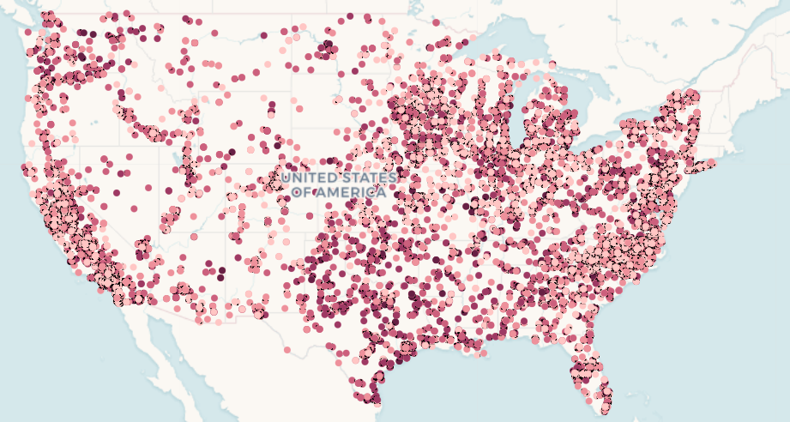
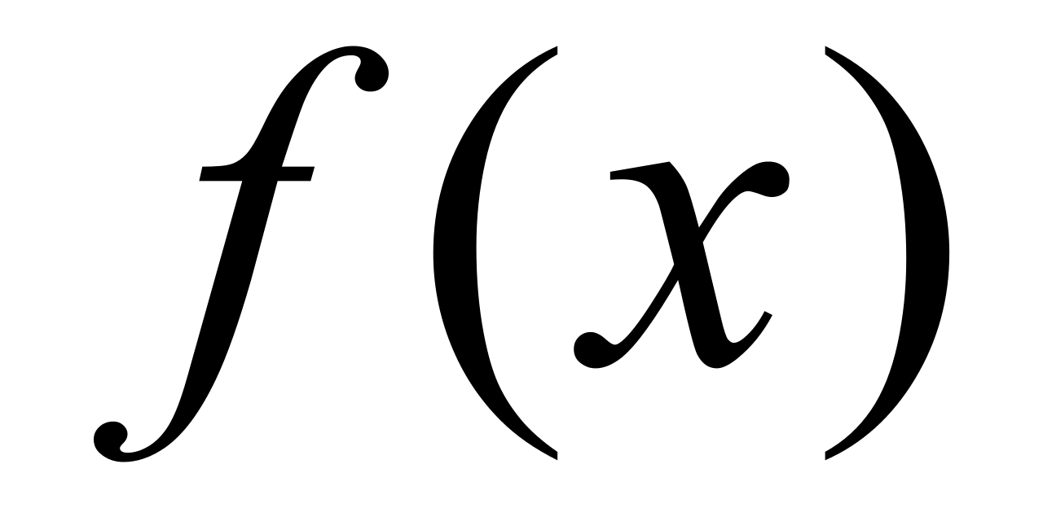
Technology
Location
Grid Saturation
3+ more
Efficiency
Fuel
EIA-923
Generation and Costs
Features
Eng. Features
Label
EIA 860
Plant Information
11,000 plants
16 years
180,000 samples
Electricity
cost
Capacity
EIA Monthly Power
Selling Price

